Slide 1


Es.Next Lecture 1
National Telecommunication Institute
Ministry of Communications and Information Technology

Slide 2
Agenda
Introduction about ES.Next
Const & let
New String Methods(startswith , endswith , includes)
Template Literals (Template Strings)
Arrow function
Destructuring
Rest parameter , Spread Operator
Default Parameters
New Array Methods (filter , find , findIndex , map)
For of loop

Slide 3
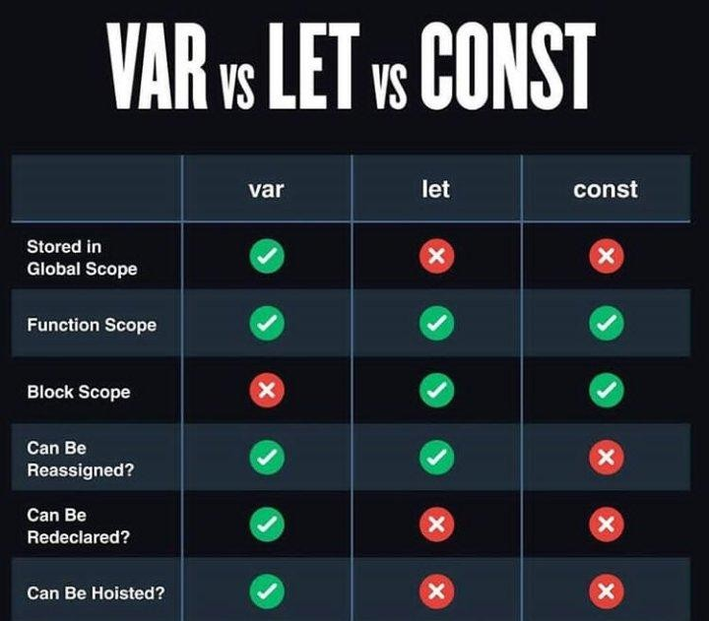
Const & let
-`let` is a signal that the variable may be reassigned, such as a counter in a loop, or a value swap in an algorithm. It also signals that the variable will be used only in the block it’s defined in, which is not always the entire containing function.
-`const` is a signal that the identifier won’t be reassigned

Slide 4
New String Methods
-startsWith() returns a Boolean value—true or false—depending on whether the string starts with the substring you have specified.
- is the opposite of the
method. The
endsWith()
startsWith()
endsWith() method determines if a string ends with a particular set of characters.
-includes() method returns true if an array contains a specified value.The includes() method returns false if the value is not found. The includes() method is case sensitive.

Slide 5

Template Literals

Slide 6
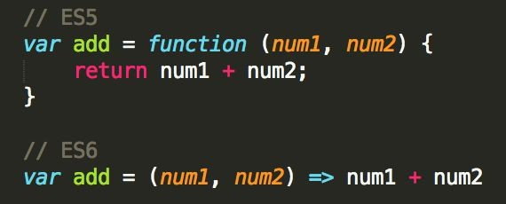
An arrow function expression is a compact alternative to a traditional function expression, but is limited and can't be used in all situations.
ARROW Function

Slide 7
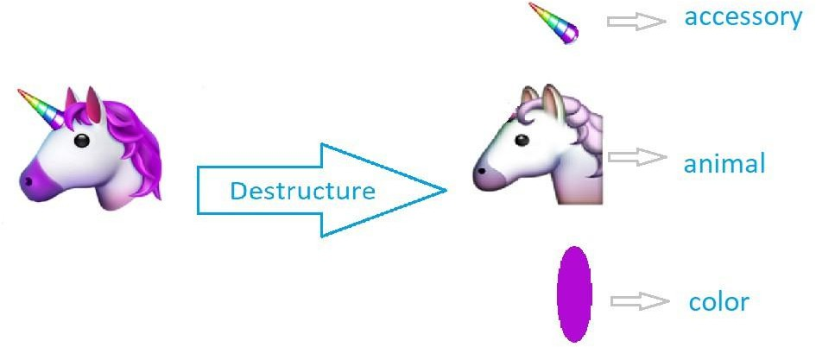
Destructuring

Slide 8
Rest Parameters & Spread Operator
The spread operator allows us to spread the value of an array (or any iterable) across zero or more arguments in a function or elements in an array (or any iterable).
The rest parameter allows us to pass an indefinite number of parameters to a function and access them in an array.

Slide 9
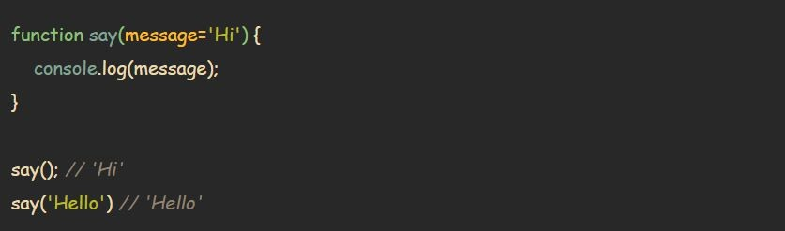
Default Parameters

Slide 10


New Array Methods
filter
vs
map

Slide 11
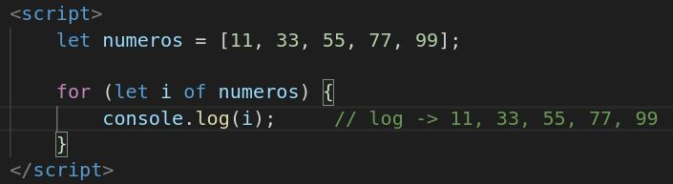
For of

Slide 12
Thank you

